Slide 1
UPPER SIXTH ARTS
GEOGRAPHY
Practical Work 3
Dependency Ratio and Population Pyramids
Notes:
Good morning, class, and welcome to our geography lesson. I am your geography teacher, Mr Kamdem. Today we are starting Practical Work 3: Dependency Ratio and Population Pyramids.

Slide 2
CLASS INFO
Class, Chapter and Duration
Class | Upper Sixth Arts
Chapter | Module 4: Understanding and managing population dynamics across the world in general and Cameroon in particular
Duration | 2 periods (2 × 50 minutes)
Notes:
This lesson is for Upper Sixth Arts. It belongs to Module 4: Understanding and managing population dynamics across the world in general and Cameroon in particular. We shall need 2 periods to cover it.

Slide 3
IDENTIFICATION
Lesson Identification
Topic | Population Structure and Composition
Sub-topic | Age-Sex Pyramids
Lesson | Practical Work 3: Dependency Ratio and Population Pyramids
Notions / Concepts | Dependency ratio, young dependants, elderly dependants, working-age population, interpretation.
Syllabus focus | Definition and calculation of the dependency ratio; worked examples; interpretation of the results.
Competence | Learners are able to calculate and interpret the dependency ratio from population data.
Notes:
Our topic is Population Structure and Composition, and the sub-topic is Age-Sex Pyramids. The key notions we shall use today are: dependency ratio, young dependants, elderly dependants, working-age population, interpretation. At the end, you should be able to do this: learners are able to calculate and interpret the dependency ratio from population data.

Slide 4

HOMEWORK CORRECTION
Correction of the Homework
Question (Lesson 7: Population Pyramids):
Write the formula of the dependency ratio.
Notes:
Before we start the new lesson, let us correct the homework I gave you at the end of Lesson 7: Population Pyramids. The question was: Write the formula of the dependency ratio. Take out your exercise books.

Slide 5
HOMEWORK CORRECTION
Correction: Possible Answer
Dependency ratio = (people aged 0–14 + people aged 65 and over) ÷ people aged 15–64 × 100.
Notes:
Here is a good answer. Dependency ratio = (people aged 0–14 + people aged 65 and over) ÷ people aged 15–64 × 100. Compare it with your own answer and correct your work in red.

Slide 6
LESSON PLAN
Lesson Plan
Correction of the homework
Objectives and recall
Real-life situation and action to take
Learning activities
Board summary
Evaluation, remediation and homework
Notes:
Here is the plan of our lesson today. First, we shall correct the homework. Then we shall look at the objectives and recall what you already know. After that, we shall study a situation from real life and the action to take, and do the learning activities. Finally, we shall copy the board summary, do the evaluation and the remediation, and I will give you the homework.

Slide 7
OBJECTIVES
Objectives
By the end of this lesson, you should be able to:
Define the dependency ratio.
Calculate the dependency ratio from data.
Interpret the result in words.
Notes:
Take your time to copy this part; we will continue together.

Slide 8
OBJECTIVES
Objectives (continued)
Compare dependency ratios of different countries.
Notes:
By the end of this lesson, you should be able to do four things. Number 1: define the dependency ratio. Number 2: calculate the dependency ratio from data. Number 3: interpret the result in words. Number 4: compare dependency ratios of different countries.

Slide 9
PREVIOUS KNOWLEDGE
Previous Knowledge
Young dependants are aged 0–14.
Old dependants are aged 65 and over.
The working population is aged 15–64.
Notes:
Let us first remember what you already know. Young dependants are aged 0–14. Old dependants are aged 65 and over. The working population is aged 15–64. Keep this in mind, because we shall build on it today.

Slide 10
REAL-LIFE SITUATION
Situation in Real Life
A development NGO in Garoua compares two districts.
In the first, there are 2,000 children, 800 elderly people and 3,000 adults of working age; in the second, the adults are much more numerous than the dependants.
Notes:
Take your time to copy this part; we will continue together.

Slide 11
REAL-LIFE SITUATION
Situation in Real Life (continued)
The NGO manager wants to know where families carry the heaviest burden.
He asks: "How do we calculate and explain the dependency ratio?"
Notes:
Listen carefully to this situation from real life. A development NGO in Garoua compares two districts. In the first, there are 2,000 children, 800 elderly people and 3,000 adults of working age; in the second, the adults are much more numerous than the dependants. The NGO manager wants to know where families carry the heaviest burden. He asks: "How do we calculate and explain the dependency ratio?" Think about it, because I am going to ask you some questions.

Slide 12
REAL-LIFE SITUATION
Situation: Question 1
What is the problem in the situation?
Notes:
Question 1: What is the problem in the situation? Think for a moment, then raise your hand to answer.

Slide 13
REAL-LIFE SITUATION
Answer
The manager does not know how to calculate and interpret the dependency ratio.
Notes:
Good. The manager does not know how to calculate and interpret the dependency ratio.

Slide 14
REAL-LIFE SITUATION
Situation: Question 2
Who are the dependants in the first district?
Notes:
Question 2: Who are the dependants in the first district? Think for a moment, then raise your hand to answer.

Slide 15
REAL-LIFE SITUATION
Answer
The 2,000 children and the 800 elderly people.
Notes:
Good. The 2,000 children and the 800 elderly people.

Slide 16
REAL-LIFE SITUATION
Situation: Question 3
Who supports them?
Notes:
Question 3: Who supports them? Think for a moment, then raise your hand to answer.

Slide 17
REAL-LIFE SITUATION
Possible Answer
The 3,000 adults of working age.
Notes:
Good. The 3,000 adults of working age.

Slide 18
ACTION TO TAKE
Action to Take
Always show the formula, the working and a sentence of interpretation when calculating a ratio.
Notes:
From this situation, the action we are working towards in this lesson is the following: always show the formula, the working and a sentence of interpretation when calculating a ratio.

Slide 19
JUSTIFICATION
Justification of the Lesson
This practical work helps us to measure the burden on workers, a key tool for planning and a frequent examination exercise.
Notes:
Why is this lesson important for you? This practical work helps us to measure the burden on workers, a key tool for planning and a frequent examination exercise.

Slide 20
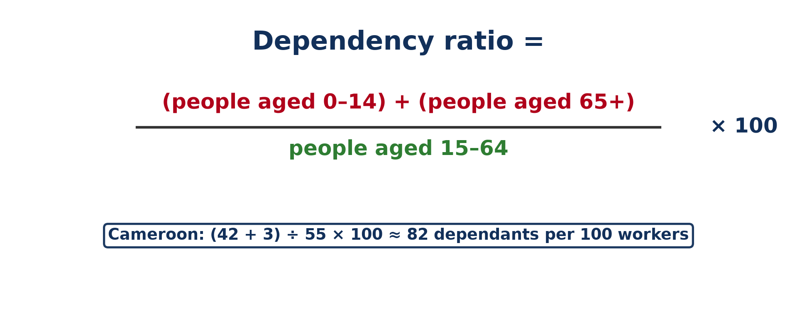
1. FORMULA
Activity 1
The dependency ratio.
Notes:
Activity 1. Look carefully at this diagram: the dependency ratio. Observe every detail before I ask the question.

Slide 21
1. FORMULA
Activity 1: Question
Which age groups are the dependants?
Notes:
Here is the question for Activity 1: Which age groups are the dependants? Take one minute to think and write your answer in your rough notebook.

Slide 22
1. FORMULA
Activity 1: Answer
People aged 0–14 and people aged 65 and over.
Notes:
Let us check the answer together. People aged 0–14 and people aged 65 and over.

Slide 23
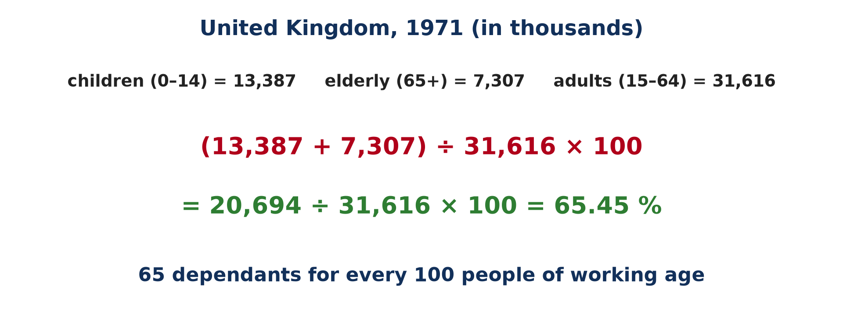
2. CALCULATION
Activity 2
A worked example: UK, 1971.
Notes:
Activity 2. Look carefully at this picture: a worked example: UK, 1971. Observe every detail before I ask the question.

Slide 24
2. CALCULATION
Activity 2: Question
What is the dependency ratio of the UK in 1971?
Notes:
Here is the question for Activity 2: What is the dependency ratio of the UK in 1971? Take one minute to think and write your answer in your rough notebook.

Slide 25
2. CALCULATION
Activity 2: Answer
65.45 %.
Notes:
Let us check the answer together. 65.45 %.

Slide 26

2. CALCULATION
Activity 3
Children and adults.
Notes:
Activity 3. Look carefully at this picture: children and adults. Observe every detail before I ask the question.

Slide 27
2. CALCULATION
Activity 3: Question
Calculate the ratio: 2,000 children, 800 elderly and 3,000 adults.
Notes:
Here is the question for Activity 3: Calculate the ratio: 2,000 children, 800 elderly and 3,000 adults. Take one minute to think and write your answer in your rough notebook.

Slide 28
2. CALCULATION
Activity 3: Answer
(2,000 + 800) ÷ 3,000 × 100 ≈ 93.3 %.
Notes:
Let us check the answer together. (2,000 + 800) ÷ 3,000 × 100 ≈ 93.3 %.

Slide 29
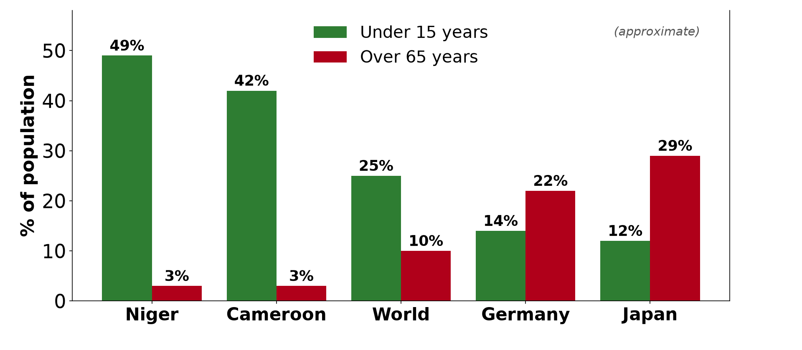
3. INTERPRETATION
Activity 4
Young and old people in some countries.
Notes:
Activity 4. Look carefully at this diagram: young and old people in some countries. Observe every detail before I ask the question.

Slide 30
3. INTERPRETATION
Activity 4: Question
Which kind of dependants dominates in Cameroon?
Notes:
Here is the question for Activity 4: Which kind of dependants dominates in Cameroon? Take one minute to think and write your answer in your rough notebook.

Slide 31
3. INTERPRETATION
Activity 4: Answer
The young dependants (children).
Notes:
Let us check the answer together. The young dependants (children).

Slide 32
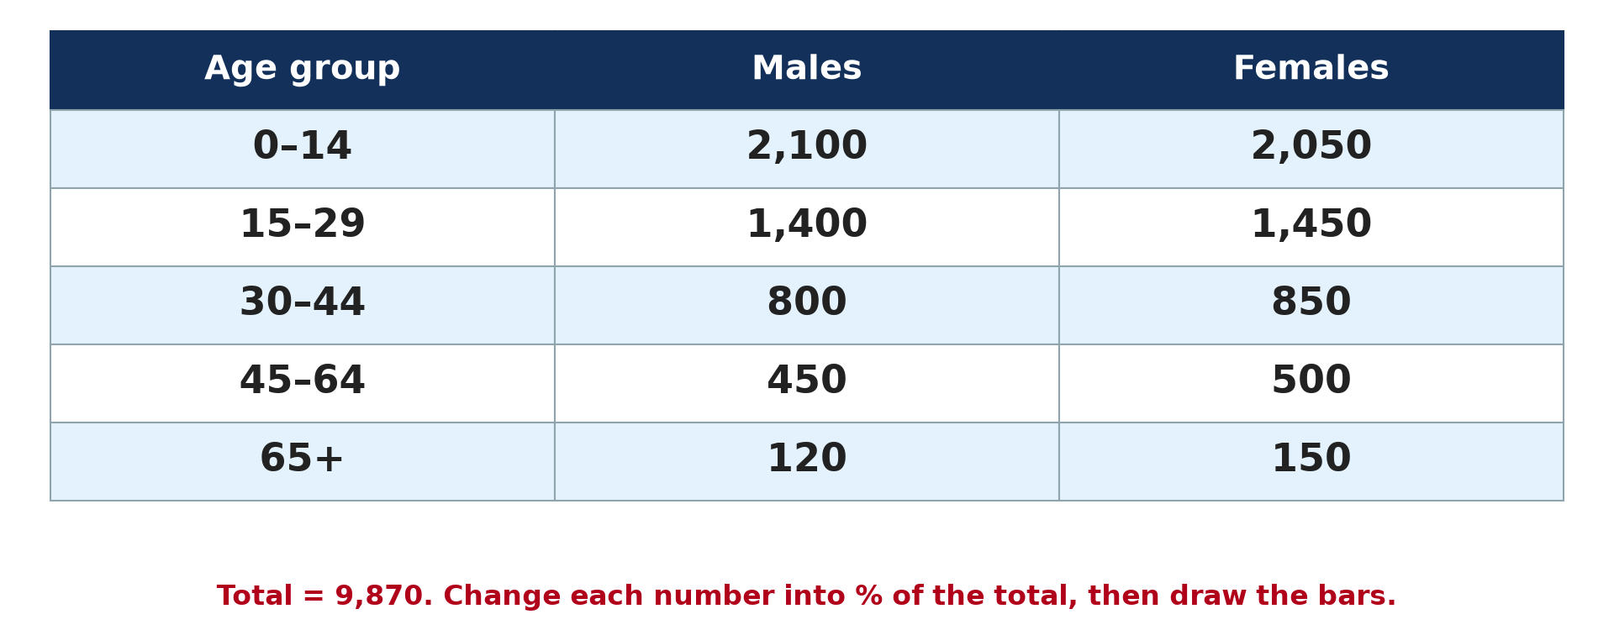
3. INTERPRETATION
Activity 5
Data of a population.
Notes:
Activity 5. Look carefully at this diagram: data of a population. Observe every detail before I ask the question.

Slide 33
3. INTERPRETATION
Activity 5: Question
What does a ratio of 93 % mean?
Notes:
Here is the question for Activity 5: What does a ratio of 93 % mean? Take one minute to think and write your answer in your rough notebook.

Slide 34
3. INTERPRETATION
Activity 5: Answer
There are 93 dependants for every 100 people of working age.
Notes:
Let us check the answer together. There are 93 dependants for every 100 people of working age.

Slide 35
BOARD SUMMARY
Board Summary
Topic: Population Structure and Composition
Sub-topic: Age-Sex Pyramids
Practical Work 3: Dependency Ratio and Population Pyramids
Notes:
Now we are going to copy the board summary. Write the title and the headings neatly in your notebooks. I will give you enough time for each slide, so do not rush.

Slide 36
BOARD SUMMARY
DEFINITIONS
The key terms of this lesson are defined as follows:
Dependency ratio: It is the number of dependants (aged 0 to 14 and 65 and over) for every 100 people of working age (15 to 64).
Notes:
Let us copy the definitions. The key terms of this lesson are defined as follows. On this slide we have Dependency ratio. Write each point on a new line, with the key term first, and explain it in your own words when we revise. When you finish, we go to the next slide.

Slide 37
BOARD SUMMARY
DEFINITIONS (continued)
Working-age population: It is the people aged 15 to 64, who are expected to produce and support the others.
Population pyramid: It is a double bar graph showing the age and sex composition of a population.
Notes:
We continue with the definitions. On this slide we have Working-age population and Population pyramid. Write each point on a new line, with the key term first, and explain it in your own words when we revise.

Slide 38
BOARD SUMMARY
1. The Dependency Ratio
The dependency ratio is calculated with the following formula:
Formula: Dependency ratio = (people aged 0 to 14 + people aged 65 and over) ÷ people aged 15 to 64 × 100. The result is the number of dependants for every 100 people of working age.
Illustration: the dependency ratio
Notes:
Let us copy The Dependency Ratio. The dependency ratio is calculated with the following formula. Copy the point on Formula on the left, then draw the diagram on the right: the dependency ratio. Give it a title and label it clearly.

Slide 39
BOARD SUMMARY
1. The Dependency Ratio
Dependants and workers: The dependants are the young (0 to 14 years) and the elderly (65 years and over). The workers are the people aged 15 to 64 years.
Notes:
We continue with The Dependency Ratio. Copy the point on Dependants and workers: write the key term first, then its explanation.

Slide 40
BOARD SUMMARY
2. Worked Examples
The calculation is done as in the following examples:
Example 1: A village has 2,000 children, 800 elderly people and 3,000 adults. Its dependency ratio is (2,000 + 800) ÷ 3,000 × 100 ≈ 93.3.
Notes:
Let us copy Worked Examples. The calculation is done as in the following examples. Copy the point on Example 1: write the key term first, then its explanation.

Slide 41
BOARD SUMMARY
2. Worked Examples
Example 2 (United Kingdom, 1971): There were 13,387 children, 7,307 elderly and 31,616 adults, in thousands, so the ratio is (13,387 + 7,307) ÷ 31,616 × 100 = 65.45. This means that for every 100 people of working age, there were about 65 dependants.
Illustration: the United Kingdom in 1971
Notes:
Copy the point on Example 2 (United Kingdom, 1971) on the left, then draw the diagram on the right: the United Kingdom in 1971. Give it a title and label it clearly.

Slide 42
BOARD SUMMARY
2. Worked Examples
Example 3: A town has 6,000 children, 2,000 elderly people and 10,000 adults. Its dependency ratio is (6,000 + 2,000) ÷ 10,000 × 100 = 80.
Notes:
We continue with Worked Examples. Copy the point on Example 3: write the key term first, then its explanation.

Slide 43
BOARD SUMMARY
3. Interpretation of the Results
The dependency ratio is interpreted as follows:
A high ratio: A ratio close to or above 80 to 100 means a heavy burden on workers. It is common in developing countries with many children.
Illustration: youthful and ageing populations
Notes:
Let us copy Interpretation of the Results. The dependency ratio is interpreted as follows. Copy the point on A high ratio on the left, then draw the diagram on the right: youthful and ageing populations. Give it a title and label it clearly.

Slide 44
BOARD SUMMARY
3. Interpretation of the Results
Cameroon: The ratio of Cameroon is about 80, and most dependants are young, since about 42 % of the people are under 15 and 3 % over 65. The state must spend a lot on schools and child health.
Notes:
We continue with Interpretation of the Results. Copy the point on Cameroon: write the key term first, then its explanation.

Slide 45
BOARD SUMMARY
3. Interpretation of the Results
A low ratio: A ratio around 50 means a large working population compared with dependants. This helps economic growth and is called the demographic dividend.
Notes:
We continue with Interpretation of the Results. Copy the point on A low ratio: write the key term first, then its explanation.

Slide 46
BOARD SUMMARY
3. Interpretation of the Results
Ageing countries: In Japan and Europe, the ratio rises again, but this time because of the elderly. These countries must spend more on pensions and health care.
Notes:
We continue with Interpretation of the Results. Copy the point on Ageing countries: write the key term first, then its explanation.

Slide 47
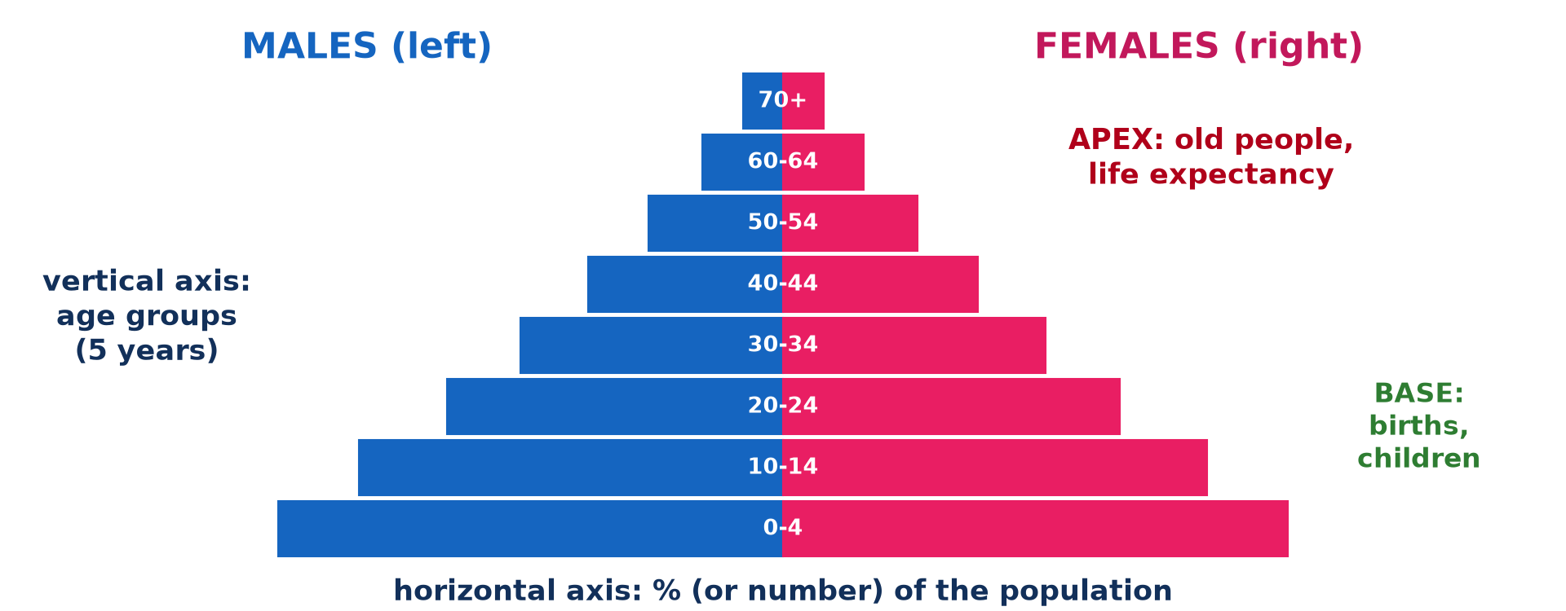
BOARD SUMMARY
4. Construction of a Population Pyramid
A population pyramid is constructed in the following steps:
Step 1, the axes: Draw a vertical axis in the middle for the age groups, in five-year cohorts from 0 to 4 at the bottom to 80+ at the top. Draw a horizontal axis on each side, with the same scale, for the percentages of males and females.
Illustration: the parts of a pyramid
Notes:
Let us copy Construction of a Population Pyramid. A population pyramid is constructed in the following steps. Copy the point on Step 1, the axes on the left, then draw the diagram on the right: the parts of a pyramid. Give it a title and label it clearly.

Slide 48
BOARD SUMMARY
4. Construction of a Population Pyramid
Step 2, the percentages: If the data are numbers, divide each group by the total population and multiply by 100. The males and females of every group must be calculated as a share of the same total.
Notes:
We continue with Construction of a Population Pyramid. Copy the point on Step 2, the percentages: write the key term first, then its explanation.

Slide 49
BOARD SUMMARY
4. Construction of a Population Pyramid
Step 3, the bars: Draw a horizontal bar for each age group, males on the left and females on the right. The length of each bar is proportional to its percentage.
Notes:
We continue with Construction of a Population Pyramid. Copy the point on Step 3, the bars: write the key term first, then its explanation.

Slide 50
BOARD SUMMARY
4. Construction of a Population Pyramid
Step 4, the finishing: Give the pyramid a title with the country and the year, and label the axes and the sexes. Shade the bars neatly so that the shape is clear.
Notes:
We continue with Construction of a Population Pyramid. Copy the point on Step 4, the finishing: write the key term first, then its explanation.

Slide 51
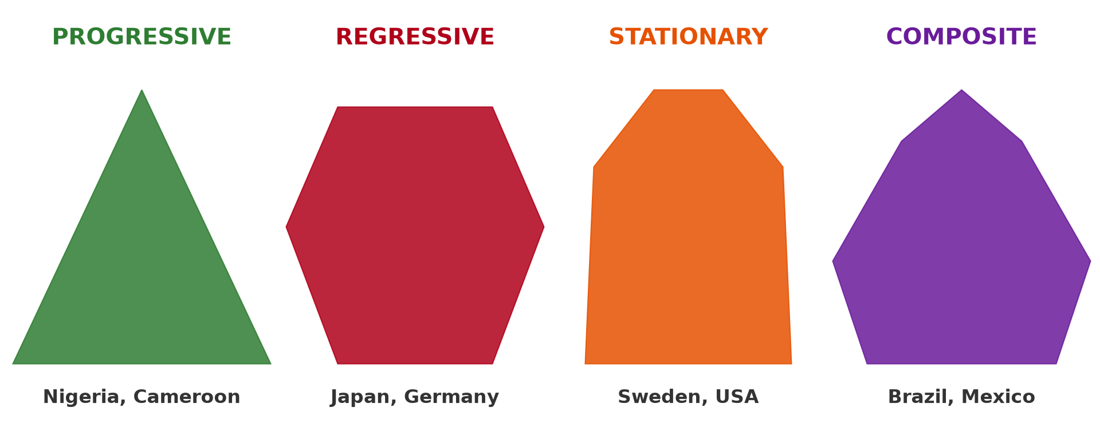
BOARD SUMMARY
5. Interpretation of a Population Pyramid
A population pyramid is interpreted in the following steps:
Describe the shape: Say whether the base is broad or narrow and whether the top is narrow or wide. Then name the type of pyramid: progressive, regressive, stationary or composite.
Illustration: the four types of pyramids
Notes:
Let us copy Interpretation of a Population Pyramid. A population pyramid is interpreted in the following steps. Copy the point on Describe the shape on the left, then draw the diagram on the right: the four types of pyramids. Give it a title and label it clearly.

Slide 52
BOARD SUMMARY
5. Interpretation of a Population Pyramid
Pick out the distinguishing features: Look for bulges and notches in particular age groups and for differences between males and females. Quote figures read from the graph.
Notes:
We continue with Interpretation of a Population Pyramid. Copy the point on Pick out the distinguishing features: write the key term first, then its explanation.

Slide 53
BOARD SUMMARY
5. Interpretation of a Population Pyramid
Explain the features: Explain the shape with birth rates, death rates and life expectancy. Explain the bulges and notches with migrations, wars, epidemics or baby booms.
Notes:
We continue with Interpretation of a Population Pyramid. Copy the point on Explain the features: write the key term first, then its explanation.

Slide 54
FORMATIVE EVALUATION
Evaluation 1
Calculate the dependency ratio of a population with 4,500 children, 500 elderly and 5,000 adults.
Notes:
Now let us check what you have understood. Question 1: Calculate the dependency ratio of a population with 4,500 children, 500 elderly and 5,000 adults. Answer in your exercise book.

Slide 55
FORMATIVE EVALUATION
Expected Answer
(4,500 + 500) ÷ 5,000 × 100 = 100 %.
Notes:
The expected answer is: (4,500 + 500) ÷ 5,000 × 100 = 100 %. If you got it right, well done.

Slide 56
FORMATIVE EVALUATION
Evaluation 2
Interpret a dependency ratio of 100 %.
Notes:
Now let us check what you have understood. Question 2: Interpret a dependency ratio of 100 %. Answer in your exercise book.

Slide 57
FORMATIVE EVALUATION
Expected Answer
There is one dependant for every person of working age.
Notes:
The expected answer is: there is one dependant for every person of working age. If you got it right, well done.

Slide 58
REMEDIATION
Remediation
Fill in the blanks:
Dependants are aged 0–14 and ______ and over.
The ratio is multiplied by ______.
A ratio of 65 % means 65 dependants for every ______ workers.
Notes:
For those who need more practice, fill in the blanks in your exercise book. The answers are: number 1, 65; number 2, 100; number 3, 100.

Slide 59
HOMEWORK
Homework
State the world population around 1800.
Notes:
For your homework: State the world population around 1800. We shall correct it at the beginning of our next lesson.

Slide 60
NEXT LESSON
Next Lesson
Our next lesson will be on:
Lesson 8: Historical Evolution of World Population
Notes:
Our next lesson will be on Lesson 8: Historical Evolution of World Population. Thank you for your attention, and see you next time.

Slide 61
BILINGUAL GAME
Bilingual Game (Jeu Bilingue)
English | Français
Dependency ratio | Le taux de dépendance
Working-age population | La population en âge de travailler
Formula | La formule
Calculation | Le calcul
Interpretation | L'interprétation
Burden | La charge
Notes:
Let us play the bilingual game. I say a word in English, and you give me the French word. Then we do the reverse.

Slide 62
LOGBOOK
Official Logbook (1/2)
Module / Topic | Population Structure and Composition
Lesson Title | Practical Work 3: Dependency Ratio and Population Pyramids
Expected Learning Outcomes | Define the dependency ratio. Calculate the dependency ratio from data. Interpret the result in words. Compare dependency ratios of different countries.
Competence | Learners are able to calculate and interpret the dependency ratio from population data.
Notes:
I record this information in the official logbook of the class after the lesson.

Slide 63
LOGBOOK
Official Logbook (2/2)
Matter Taught | DEFINITIONS; The Dependency Ratio; Worked Examples; Interpretation of the Results; Construction of a Population Pyramid; Interpretation of a Population Pyramid.
Evaluation | Formative evaluation and remediation exercise.
Homework | State the world population around 1800.
Enrolment / Present / Absent | ____ / ____ / ____
Achievement | To be completed after the lesson.
Notes:
I complete the second page of the logbook: the matter taught, the evaluation, the homework and the attendance.

Slide 64
TEACHER'S NOTE
Teacher's Note
Timing: Homework correction, plan, objectives 8 min | Recall, situation, action 10 min | 5 activities 30 min | Board summary (copying) 30 min | Evaluation, remediation 10 min | Homework, next lesson 5 min | Logbook 7 min
Without the projector (Activity 1): write the formula on the board.
Without the projector (Activity 2): do the calculation step by step.
Without the projector (Activity 3): let learners calculate in pairs.
Without the projector (Activity 4): compare Cameroon and Japan.
Without the projector (Activity 5): write the sentence of interpretation.
Notes:
This slide is for me, the teacher: it gives the timing of the lesson and what to do if the projector is not available.

Slide 65
REFERENCES
References
Geography Syllabus for Sixth Forms (Lower and Upper Sixth), MINESEC, 2019 — Module 4 (Population Geography).
Teacher's course notes: Mr KAMDEM E., Population Geography (USA), GBHS Garoua, 2026.
United Nations, World Population Prospects 2024.
Photo, Activity 3: “African school children” by World Resources, CC BY-NC-SA 2.0, via Flickr (https://www.flickr.com/photos/26107309@N05/2658469563)
Diagrams and animations: drawn for this lesson (Geography Department).
Notes:
These are the references and picture credits used to prepare this lesson.

